Slide 1
Fantasy
An Annotated Bibliography Presentation by Jessica Chang

Slide 2
Fantasy in YA Lit
When I was a teenager, books were my sanctuary. Reading allowed me to experience something I might not otherwise be able to. It also provided me with an escape from the mundane of everyday life. Most of the books I read fell into two genres: realistic fiction and fantasy. I used to think they were on opposite sides of the spectrum, but I came to realize that they are merely two sides of the same coin. Just because Rachel Hartman’s Seraphina is half-dragon, it doesn’t make her struggle with identity and acceptance any less real than the everyday struggles of protagonists from Sarah Dessen’s novels. The fantasy genre presents a paradox where readers are given both magic creatures and fantastical adventure as well as real-life lessons.

Slide 3
Fantasy in YA Lit
Fantasy has been attacked for its roots in the imaginary, which critics have taken to mean that its content is inherently unreal or untrue. While the landscape and its inhabitants, customs, and conflicts might be imaginary, they are also completely fathomable and rife with an emotional honesty that makes it feel real. Fantasy allows readers to take up the role of an outsider, looking in and discovering something for the first time. For all its foreignness, fantasy can gift us with real insight into our own society. By acting as outsiders, it’s as if we can see everything more clearly.

Slide 4
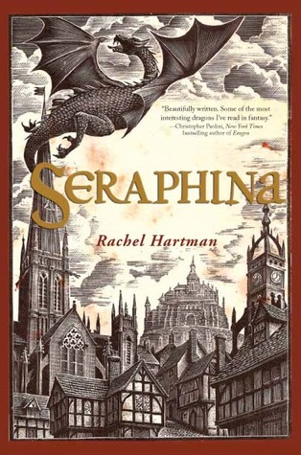
Seraphina by Rachel Hartman
The people of medieval Goredd are preparing to celebrate the 40th anniversary of their peace treaty with dragons when the heir is murdered. All signs point to the murderer being a dragon, fueling tensions that already exist between the two peoples. The main protagonist Seraphina Dombegh, along with Prince Lucian Kiggs, becomes embroiled in untangling this mystery. As they uncover hints of a sinister plot to destroy the peace, Seraphina struggles to protect her own secret: that she is half-human and half-dragon. Underneath the promise of mystery and hints of romance, the novel explores themes of racism and xenophobia that are prevalent in today’s society. Seraphina is presented in a way that ethnic or sexual minorities can relate to: born into an identity that she didn’t choose, she must deal with the shame and the lies shaped by the world she lives in. And just like in our own society, there are those who view any kind of novelty or change as a threat to their very existence.

Slide 5
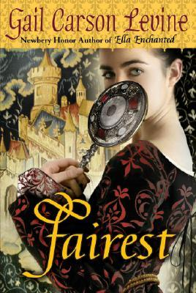
Fairest by Gail Carson Levine
In the kingdom of Ayortha, Aza is not the fairest of them all. She is thoroughly convinced that she is ugly. However, she has a lovely singing voice, which is highly valued in her society. On the other hand, Queen Ivi is beautiful but cannot sing. Fairest follows the story of how far these two women are willing to go to feel beautiful, exploring themes of self-esteem that resonate with many young women. We are constantly distracted by the idea that our external weaknesses hold us back from true happiness when our faults actually lie in the inability to accept our imperfection. These feelings are inadequacy are exacerbated by a society that encourage conventional beauty. Levine poignantly portrays the harmful effects of envy and shows how destructive self-hatred can be.

Slide 6
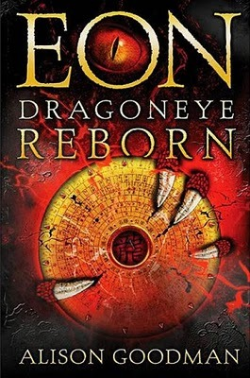
Eon: Dragoneye Reborn by Alison Goodman
Eon is a twelve-year-old boy who has been training in hopes of being chosen as a Dragoneye—an apprentice to one of the twelve energy dragons of good fortune. However, the truth is that he is actually Eona, a sixteen-year-old girl, but women are forbidden from practicing Dragon Magic. When she is chosen by a powerful dragon that hasn’t shown itself in years, Eona is forced to face the truth behind all the secrecy. The novel’s greatest strength is in its depiction of gender and the roles that women play in a parochial society. In a world where power is forbidden to women, Eona has to learn to accept herself as someone who can be a woman as well as powerful.

Slide 7
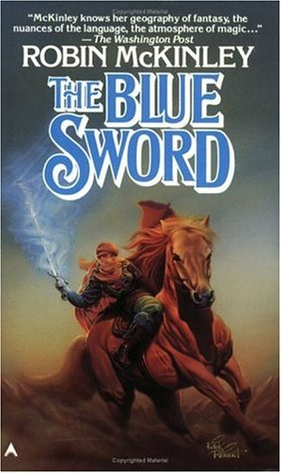
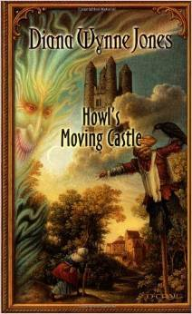
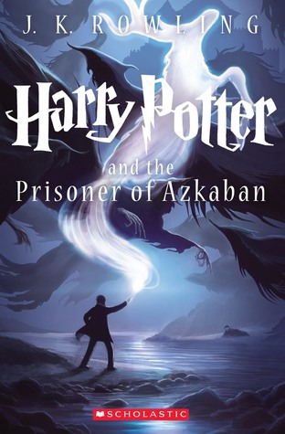
Other Books

Slide 8
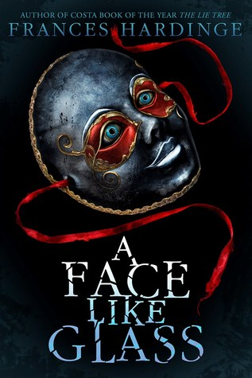
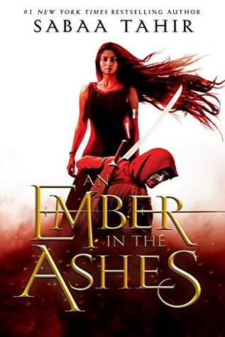
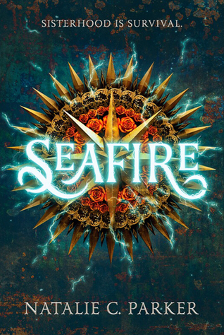
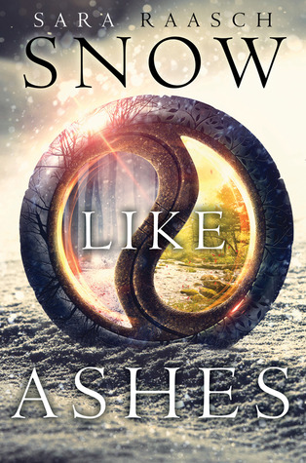
Other Books

Slide 9
The End

